Slide 1
Linux Commands

Slide 2
1. pwd : Present working Directory.
2. whoami : Current Username.
3. users : How many users are using the system.
4. date : provide date and time
5. cal : Shows the monthly calendar
6. history : shows all the command typed recently.
7. clear: clear the entire terminal.
8. cat : display content of the file.
9. nano : to open the file with editable
10. exit : closes the running terminal.
11. man :guide to command

Slide 3
12. ls: List all the files.
13. ls -l : complete details of the file.
14. ls –la : get detailed information with hidden files and directory.
15. cd : Change the directory.
16. touch : to create a file.
17. mkdir : to make the directory.
18. mv : to move the file or directory / rename the file
19. cp : to copy the file.
20. cp –r : copy from one folder to another.
21. rm : to delete a file.
22. rm –r : to remove a directory.
23. cd ~ : move directly to root

Slide 4
24. ./ : current directory
25. ../ : parent directory
26. wc : word count
27. wc –l : number of lines in a file.
28. wc –w : number of words in the file.
29. wc –c : Number of characters in a file.
30. ll : complete informations of the file

Slide 5
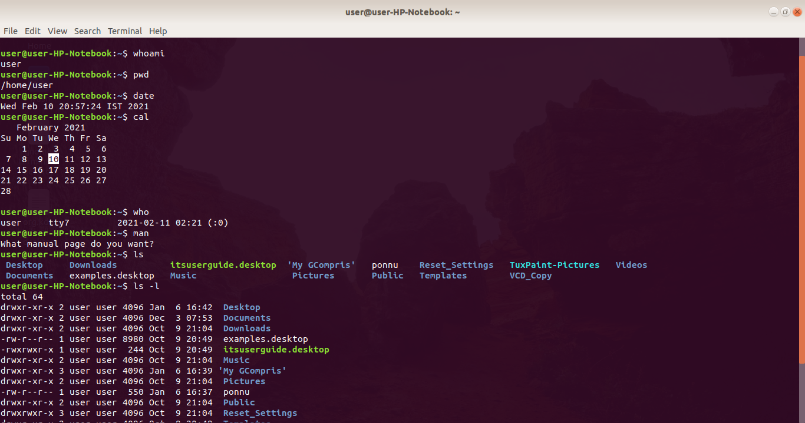

Slide 6
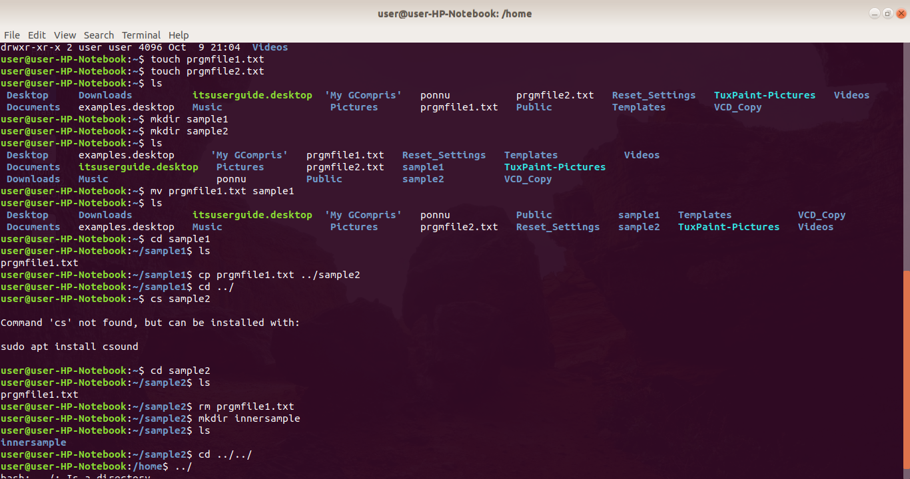

Slide 7
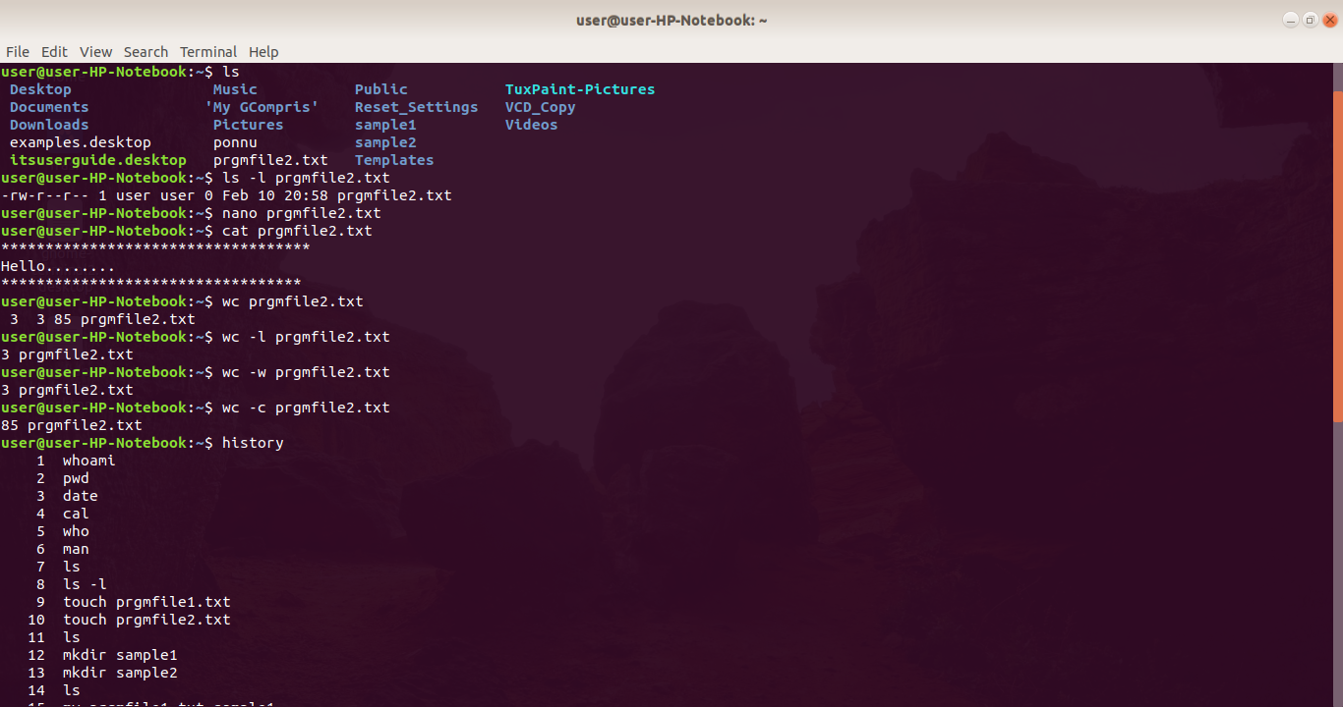

Slide 8
Standard Linux Streams
Stdin : standard input
Associated file descriptor is 0
Stdout : Standard output
Associated file descriptor is 1.
Stderr : Standard error
Associated file descriptor is 2.

Slide 9
Permissions
There are read, write and execute permissions are granted.
There are three types of permissions.
Owner permissions (u)
Group Permissions (g)
Other world permissions (o)
To change the permissions there are 2 methods.
1. Symbolic permissions
2. Absolute Permissions.
Done using chmod

Slide 10
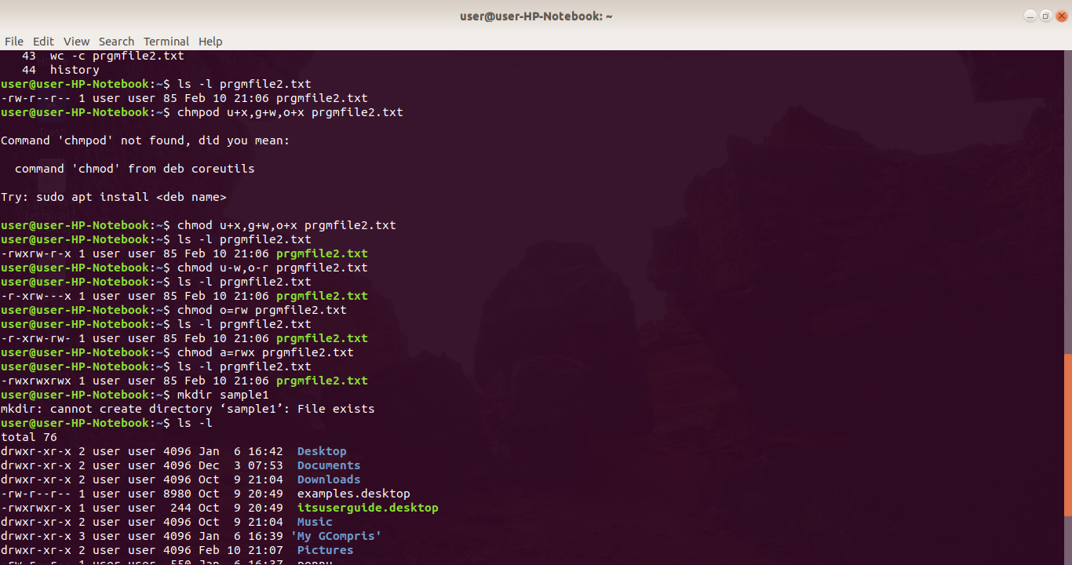

Slide 11
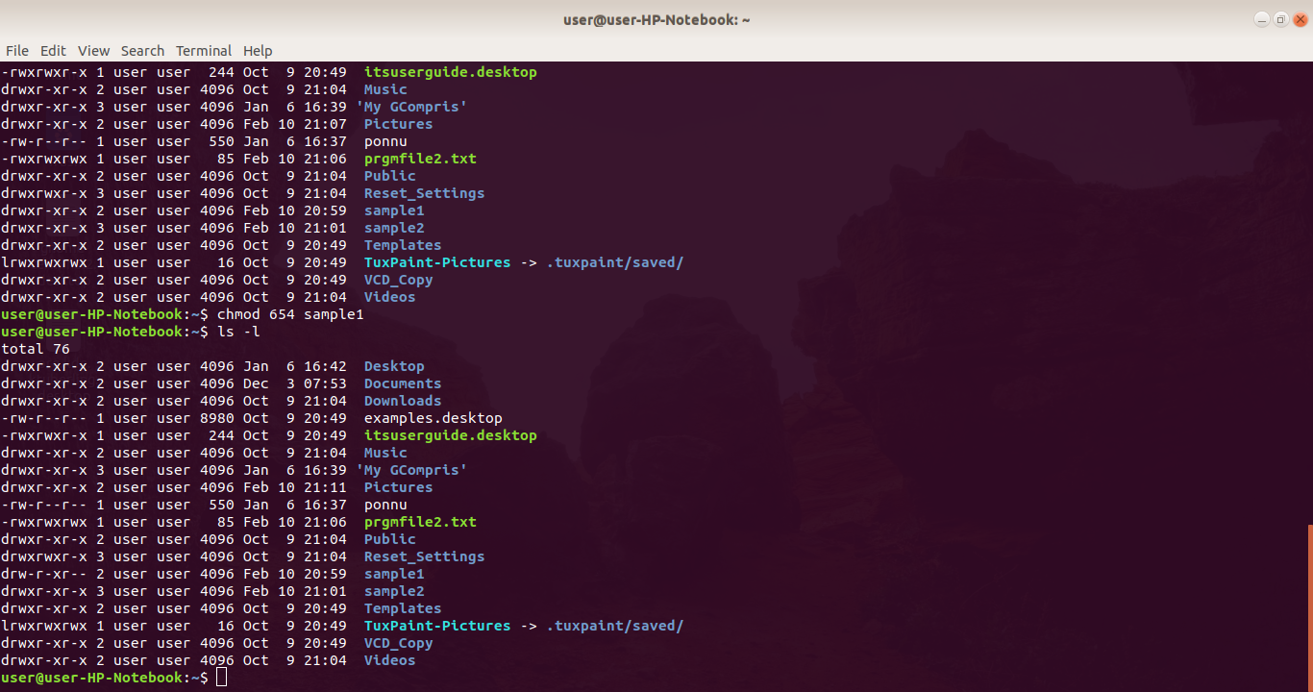

Slide 12
* for every file and directory there will have a default permissions on the basis of umask : 0002
changing owners and group:
chown : change owner
chgrp : change group
echo string : to print the sring

Slide 13
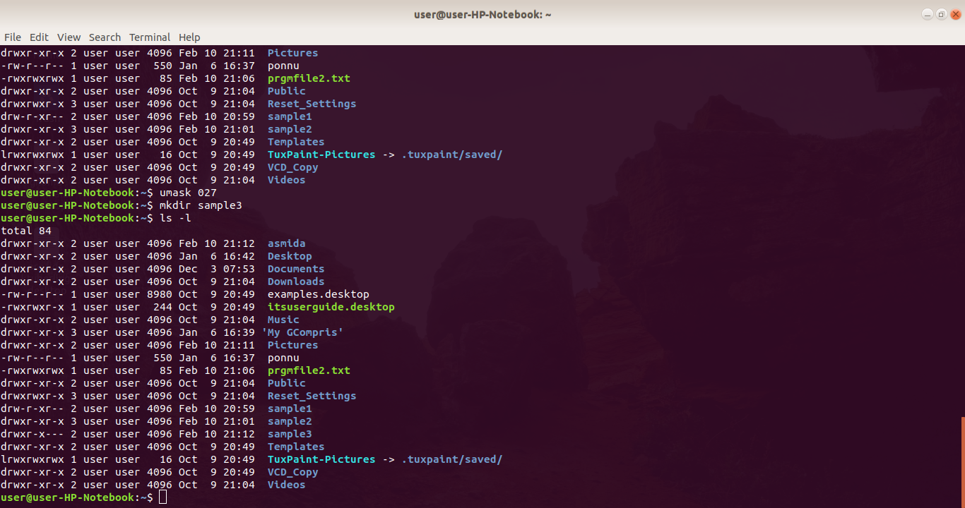

Slide 14
THANK YOU

